Slide 1
Introducing the Raspberry Pi
Nauru ICT Department
April 2016

Slide 2
What is a Raspberry Pi
Credit Card sized computer
Low priced - $5 to $35 USD
8 Million sold to date
53 versions Banana Pi, etc
Designed for Education
Low Power usage
RPi 3 - 4 Core 64 Bit ARM CPU

Slide 3
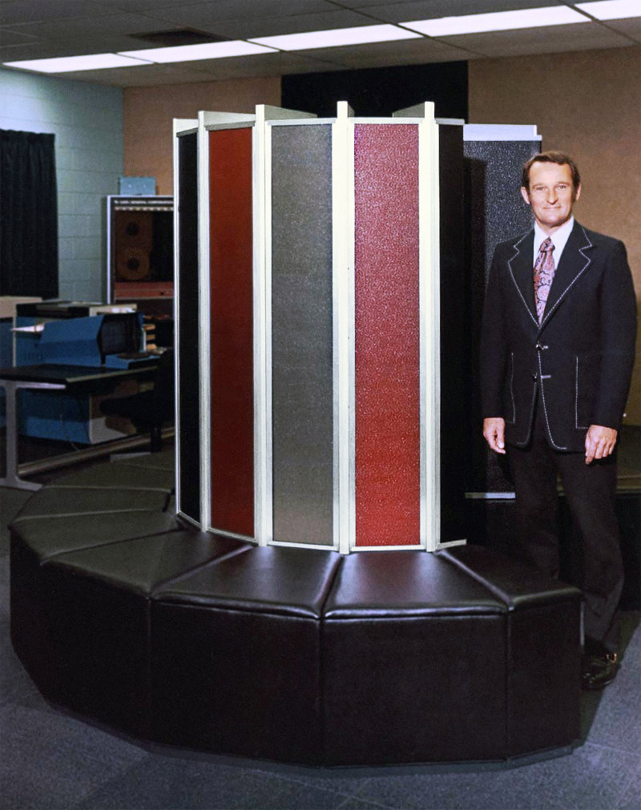
What is a Raspberry Pi
More powerful than a CRAY supercomputer 1988 era
Item | Cray | Raspberry Pi 3
Price | $8m (1988) | $35
CPUs | 1 | 1
Word size | 32 | 64
RAM | 64MB | 1GB
Cooling | Air cooled, heatsinks, fans | Air cooled, no heatsink or fan

Slide 4
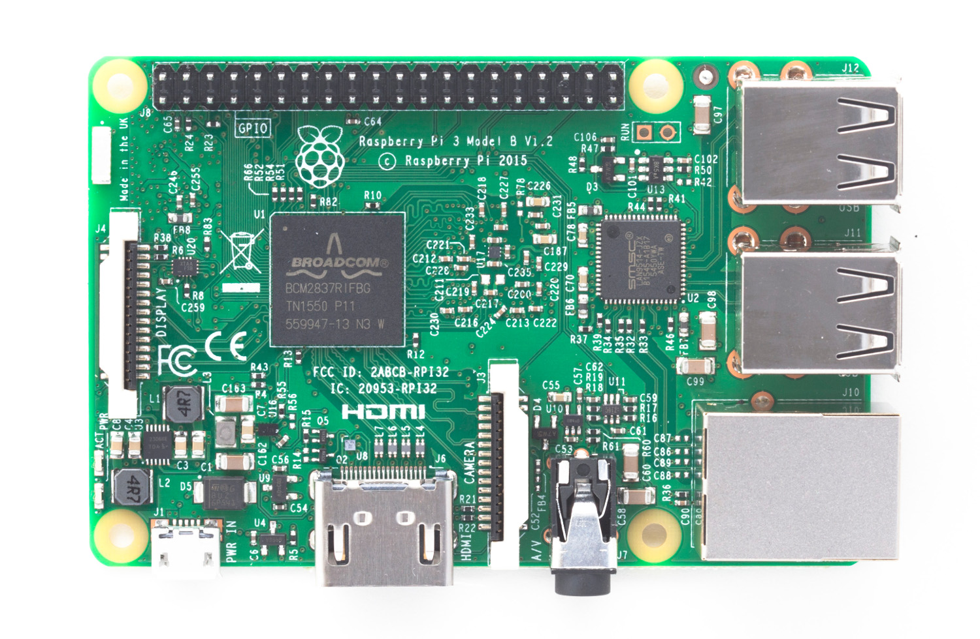
Raspberry Pi 3

Slide 5
The Basics - Power
5v micro USB power connection Just like your mobile phone

Slide 6
The Basics – A/V
HDMI - Video & Audio - Works with modern TV and Monitors

Slide 7
The Basics – Connections
Four USB 2.0 ports

Slide 8
The Basics – Connections
10/100 Ethernet connectivity RJ45

Slide 9
The Basics – Connections
WiFi - 2.4GHz 802.11n wireless and Bluetooth 4.1

Slide 10
The Basics – Connections
GPIO - 40-pin general-purpose input output

Slide 11
The Basics – Internals
SOC – system on chip - Broadcom BCM2837
ARM 4-Core ARM Cortex-A53 at 1.2GHz – GPU -1GB Ram

Slide 12
The Basics – Storage
Micro SD card – 8GB recommend up to 64GB Class 10

Slide 13
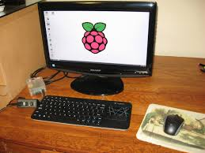
So what can I do with a Pi?
Desktop Computer

Slide 14
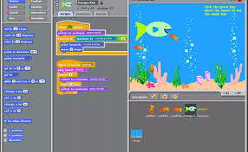
So what can I do with a Pi?
Desktop Computer
Learn Programming

Slide 15
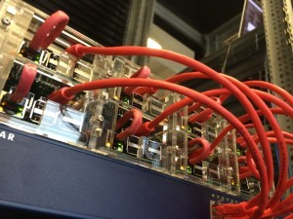
So what can I do with a Pi?
Desktop Computer
Learn Programming
Web Server

Slide 16
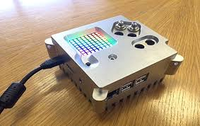
So what can I do with a Pi?
Desktop Computer
Learn Programming
Web Server
Embedded Computing

Slide 17
So what can I do with a Pi?
Desktop Computer
Learn Programming
Web Server
Embedded Computing
Super Computing (HPC)

Slide 18
The OS

Slide 19
Get Started!
Linux CL
Graphic Desktop

